Slide 1
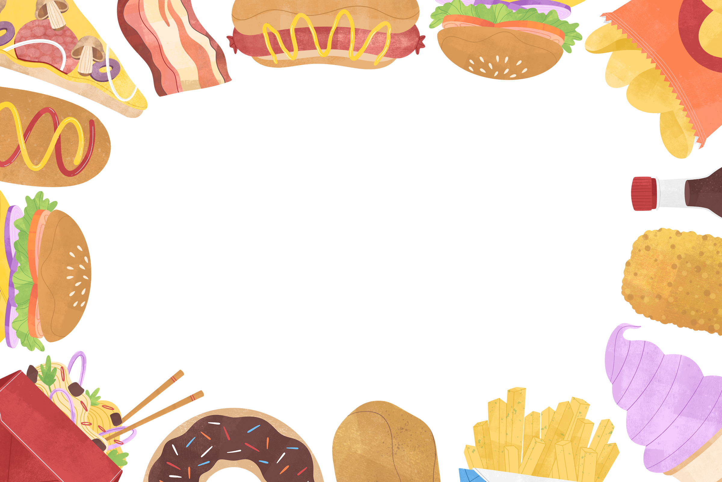
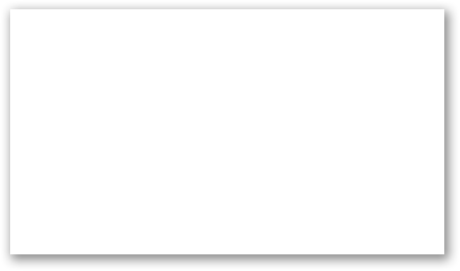
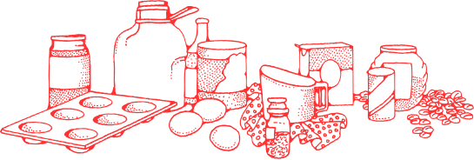
Name :Thirunavukkarasu. R
Reg no:422521104039
Email id:thirunathiruna186@gmail.com

Slide 2
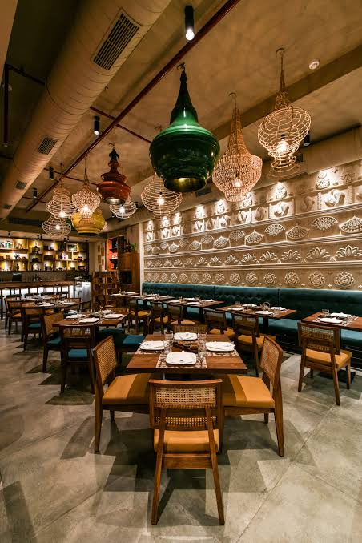
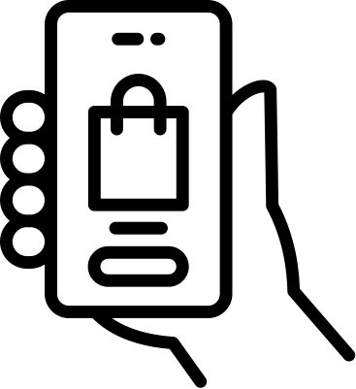

TITLE
Restaurant Reservation Chatbot

Slide 3

1
PROBLEM STATEMENT
2
PROJECT OVERVIEW
3
WHO ARE THE END USERS
Agenda
4
OUR SOLUTION & IT'S PROPOSITION
5
THE WOW IN OUR SOLUTION
6
MODELLING
7
RESULT

Slide 4
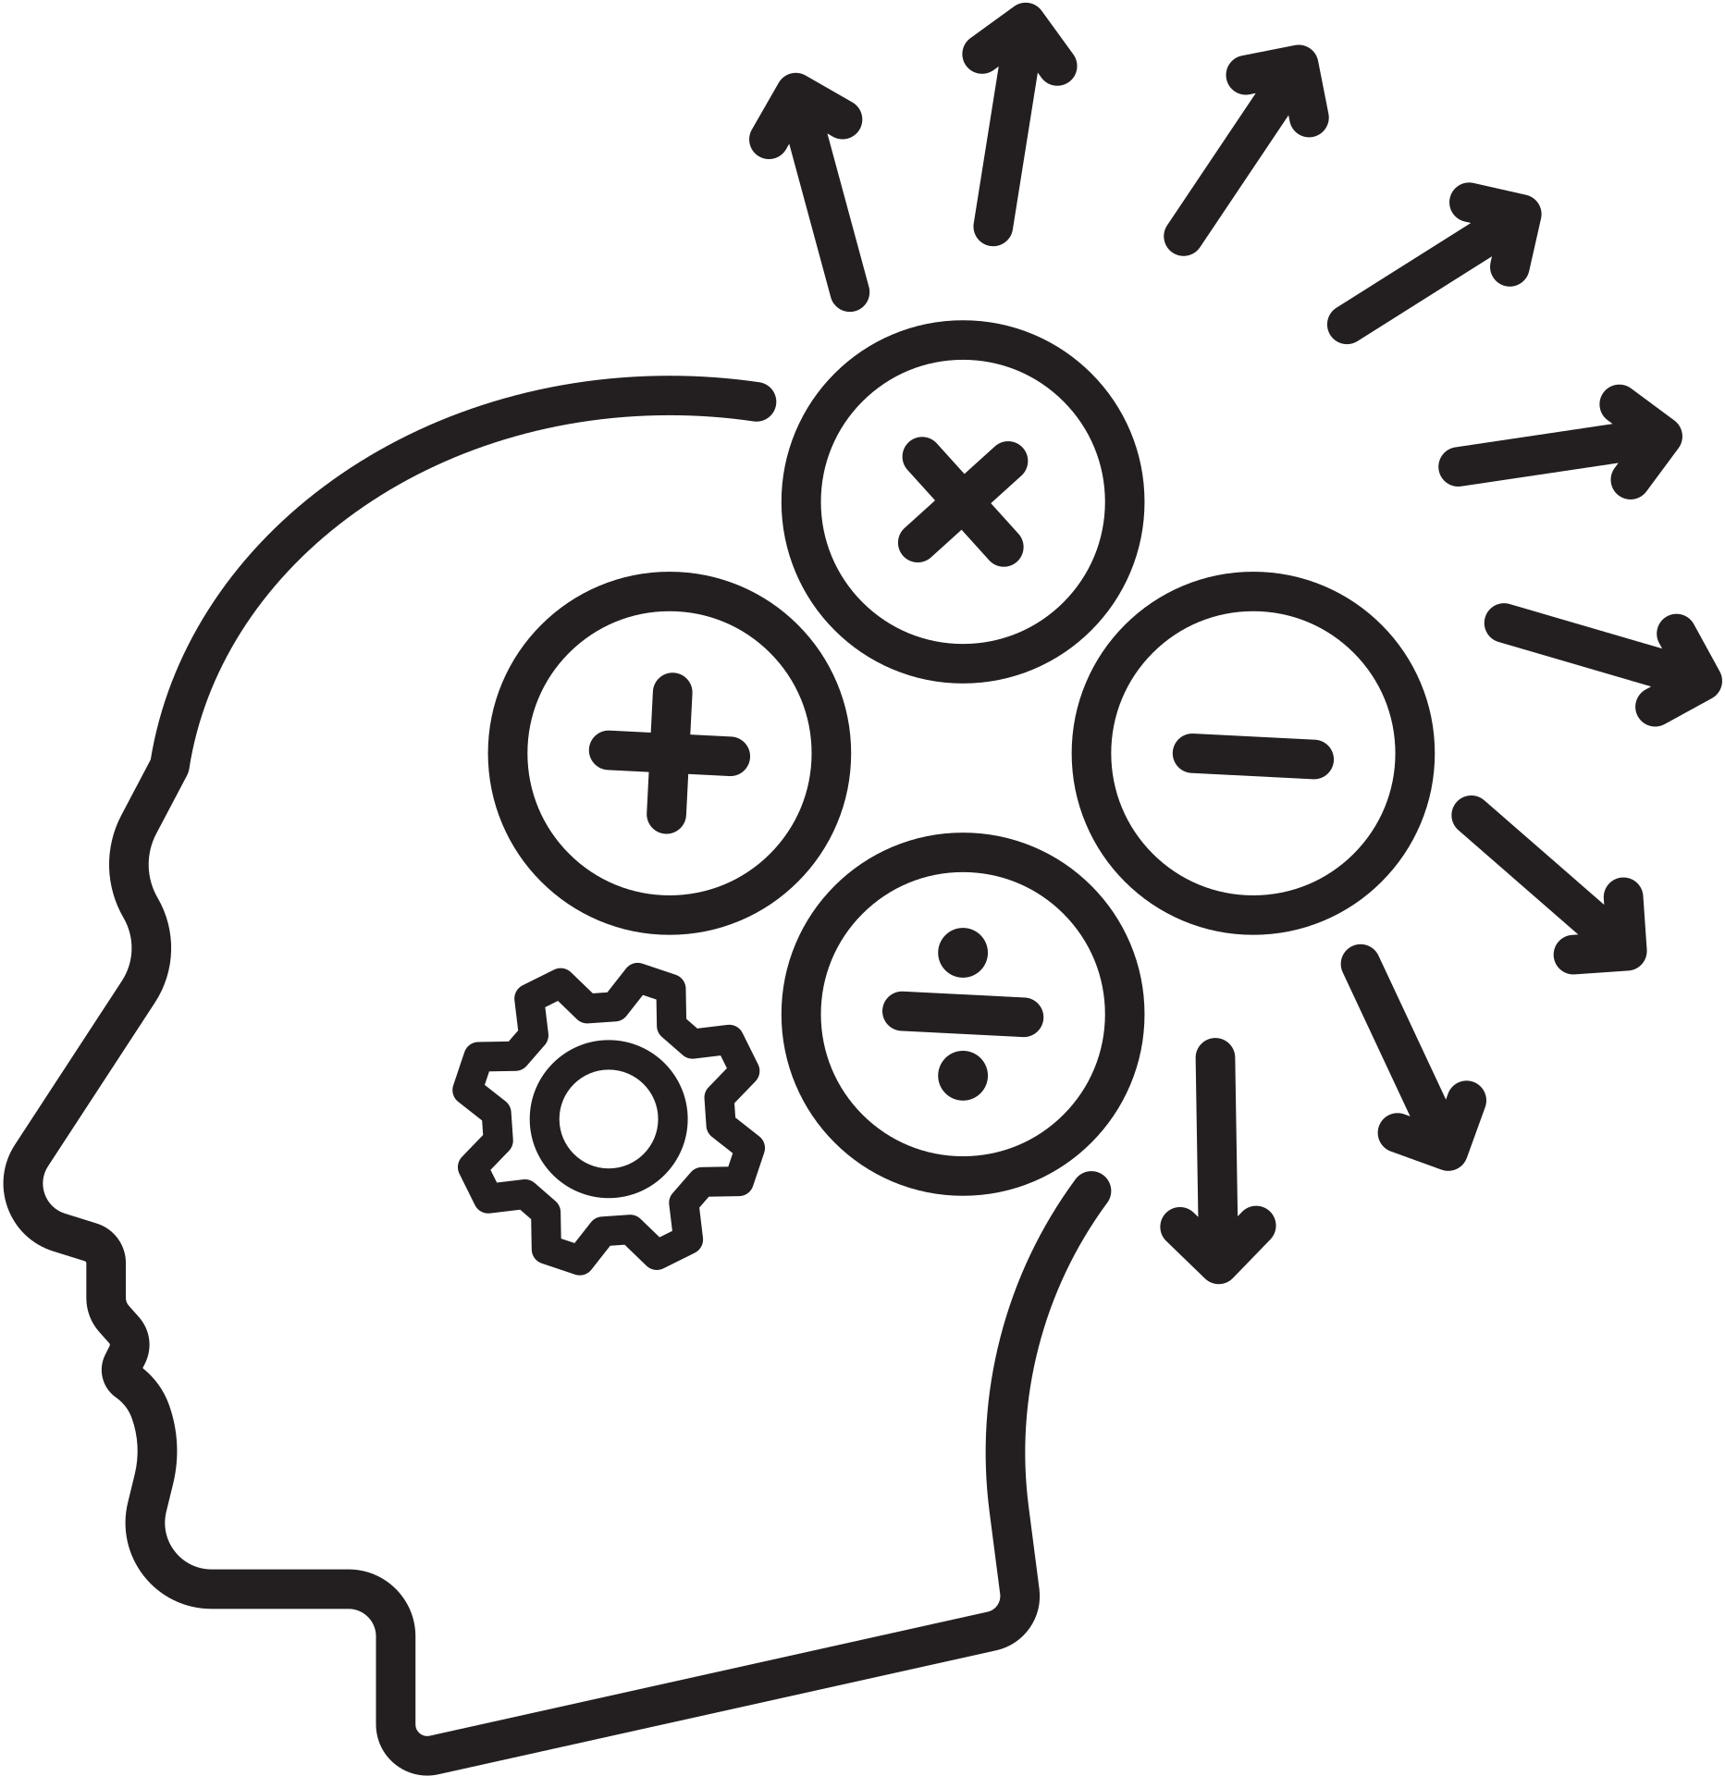
PROBLEM STATEMENT
Develop a restaurant reservation chatbot capable of assisting users in making reservations, providing information about the restaurant, and handling inquiries related to the menu, operating hours, and special requests. The chatbot should employ a neural network-based model trained on a dataset of intents and responses, enabling it to understand user queries and generate appropriate responses.

Slide 5
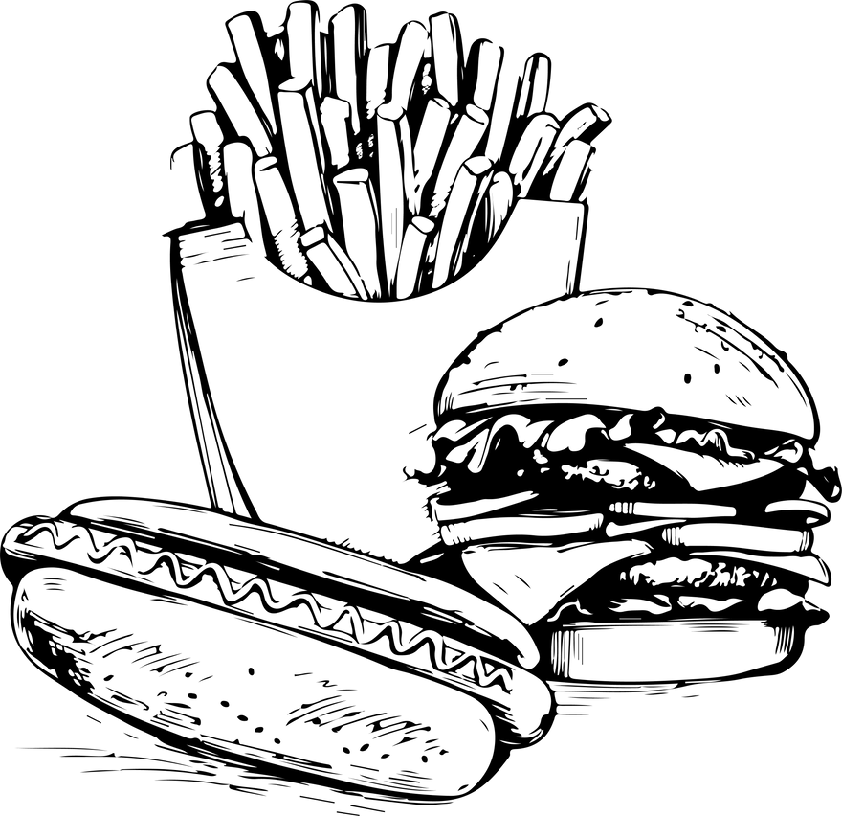
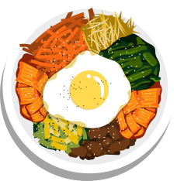

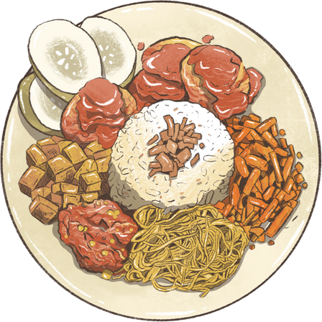
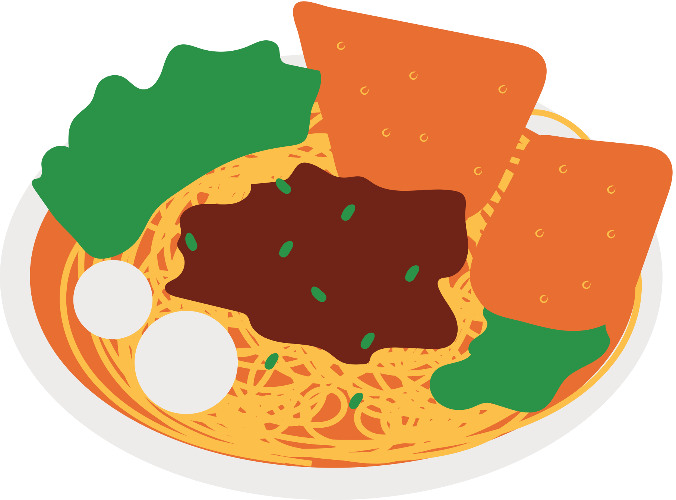
PROJECT OVERVIEW
The Restaurant Reservation Chatbot project aims to develop an AI-powered chatbot facilitating restaurant reservations, providing information, and handling inquiries. Utilizing NLP techniques and machine learning, the chatbot interprets user messages, recognizes intents, and generates appropriate responses. Key components include an NLP model, intent recognition system, dynamic response generation, reservation management, user interface, deployment, and testing. The chatbot streamlines reservation processes, enhances customer engagement, and improves the dining experience. It offers a user-friendly interface for seamless interaction and aims to increase customer satisfaction while demonstrating the potential of AI in hospitality.

Slide 6
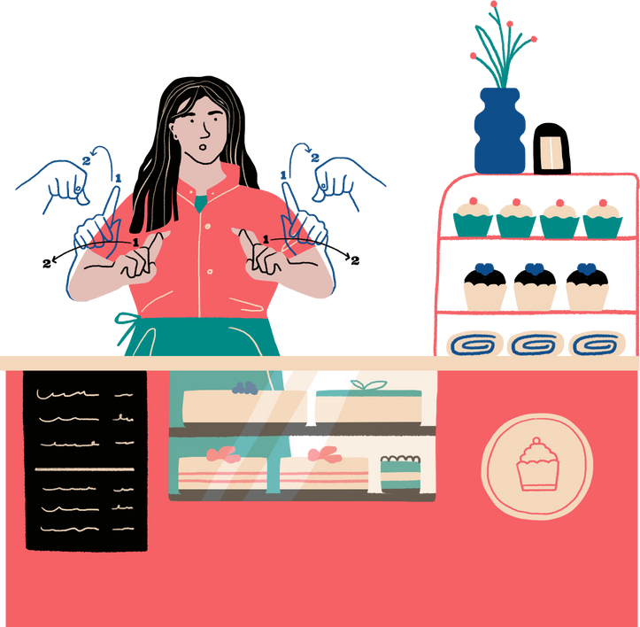
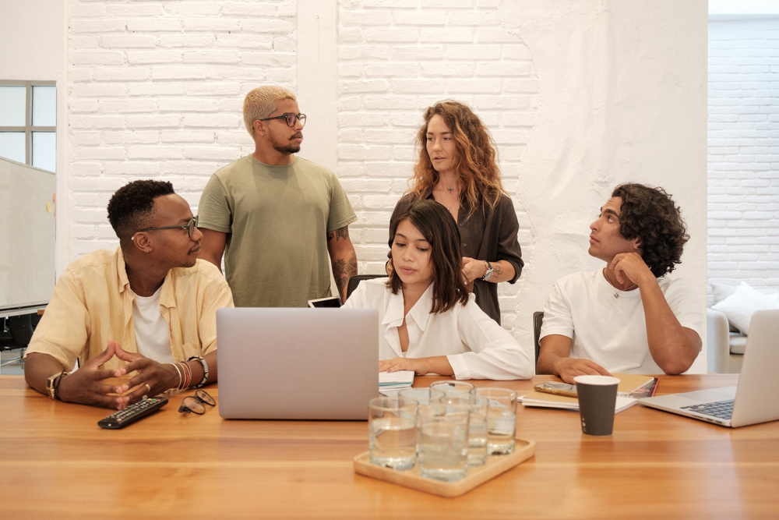
WHO ARE THE END USERS
Order
The end users of the Restaurant Reservation Chatbot are primarily individuals seeking to make reservations at the restaurant and also to enquiry the opening and closing time, menu items and etc....
users

Slide 7
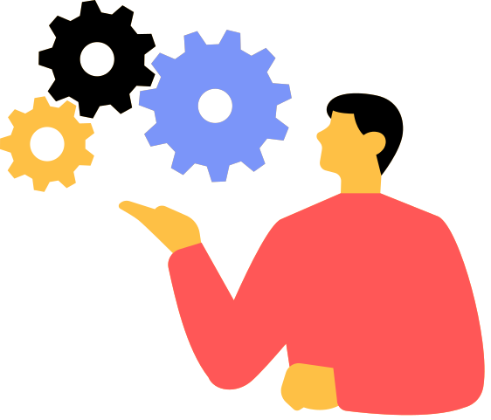
OUR SOLUTION & IT'S PROPOSITION
We Created this chatbot using the AI Machine Learning Techniques.
First We Created this using the following ways,
1)Training the model with dataset
2)Integrating with Flask
3)User Interface

Slide 8
1)TRAINING THE MODEL
Loading the Data:
Imagine a file named "full.json" that stores conversations between you and a chatbot.
The code reads this file to understand what people might ask the chatbot.
Getting the Words and Categories:
The code goes through each conversation in the file.
It separates the user's question (like "Hi!") from the chatbot's answer (like "Hello!").
It keeps track of all unique words used in the questions (like "Hi", "How", "What").
It remembers the different types of conversations (like greetings, questions, etc.).

Slide 9
Turning Questions into Numbers:
The code creates a special code for each question. Imagine a big list where each word has a number.
For each question, the code checks which words are there and creates a list of 0s and 1s.
If a word is in the question (like "Hi"), the code puts a 1 in its place.
If a word is not there (like "Bye"), the code puts a 0.
This way, the computer can understand the questions better.
Training the Brain:
Imagine the chatbot's brain is a complex machine with many parts.
The code uses the questions (turned into numbers) and the conversation types (like greetings) to train this brain.
By showing the brain many questions and their types, it learns to recognize patterns and guess the conversation type for new questions
Saving the Knowledge:
Once the brain is trained, the code saves its knowledge in a file named "my_chatbot_model.h5".
This file contains everything the chatbot learned from the conversations, so it can answer new questions later.
Dataset:
I used the dataset called full.json which contains large amount of intents to train our chatbot

Slide 10
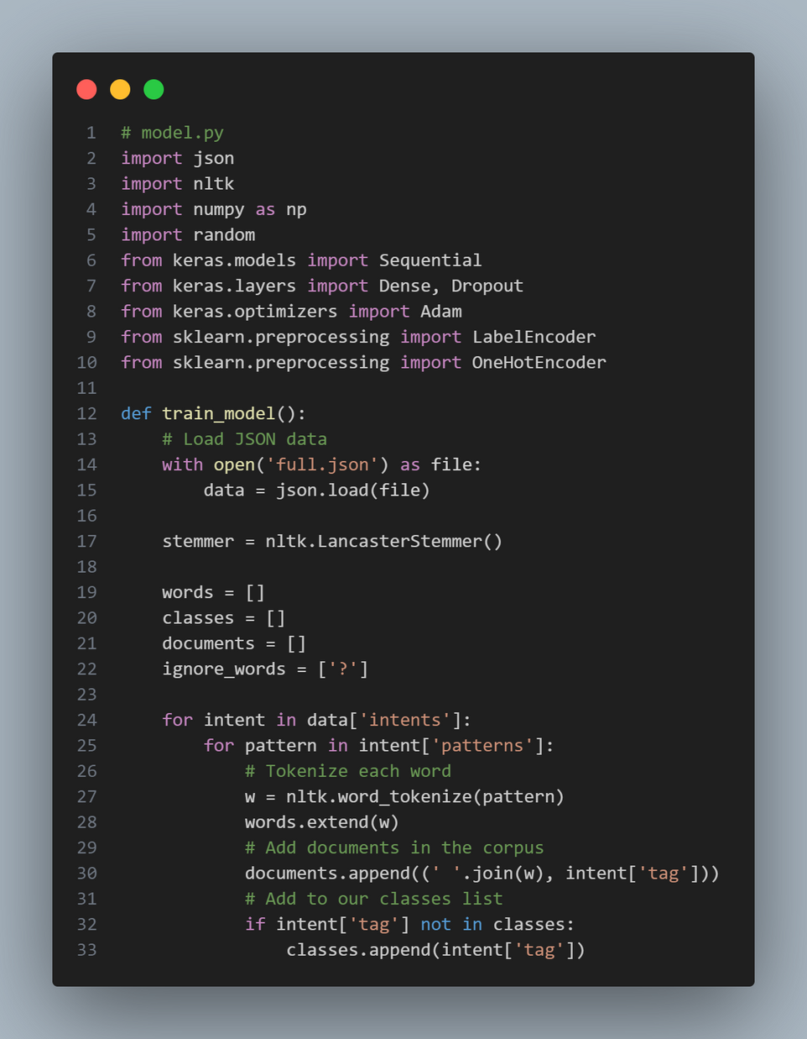
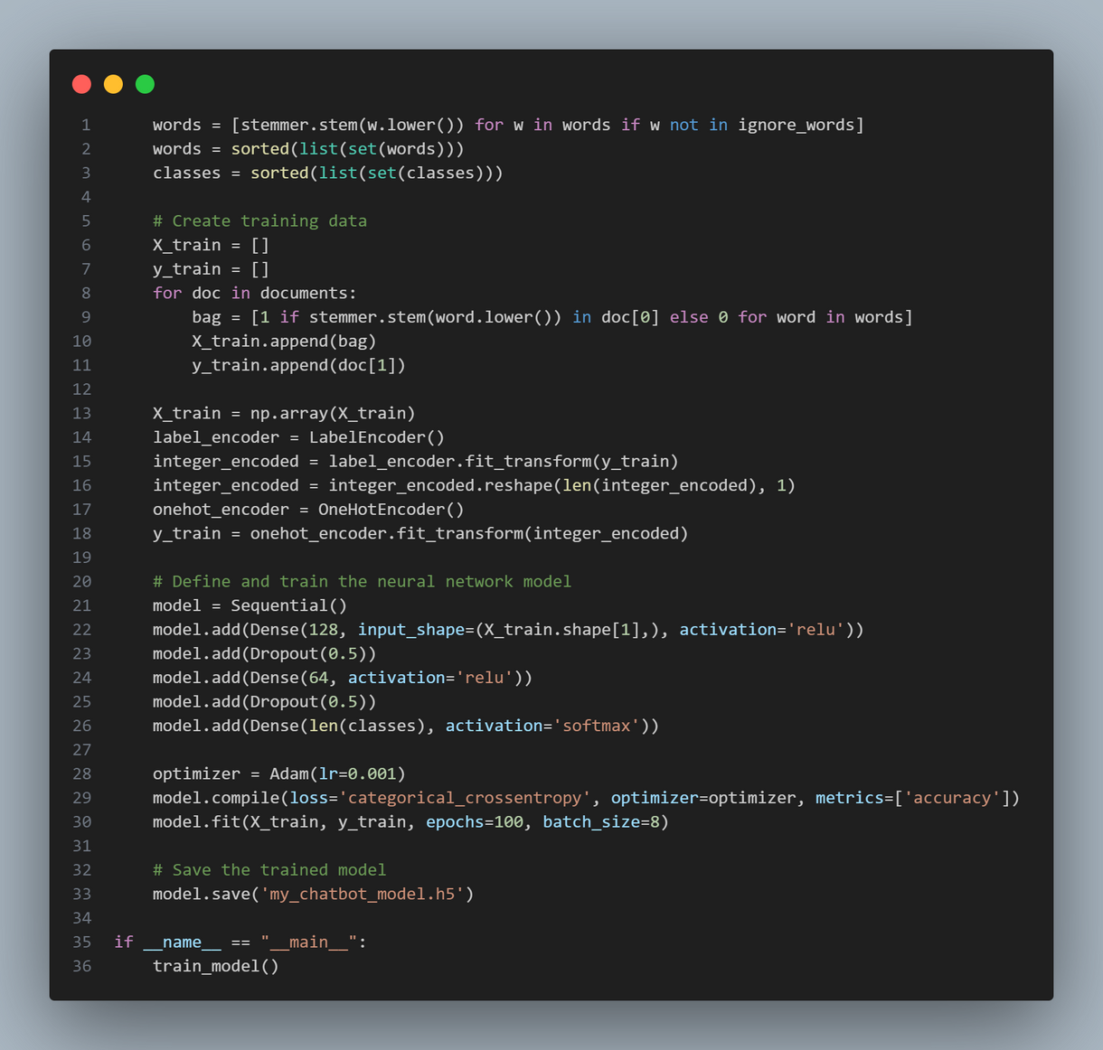

Slide 11
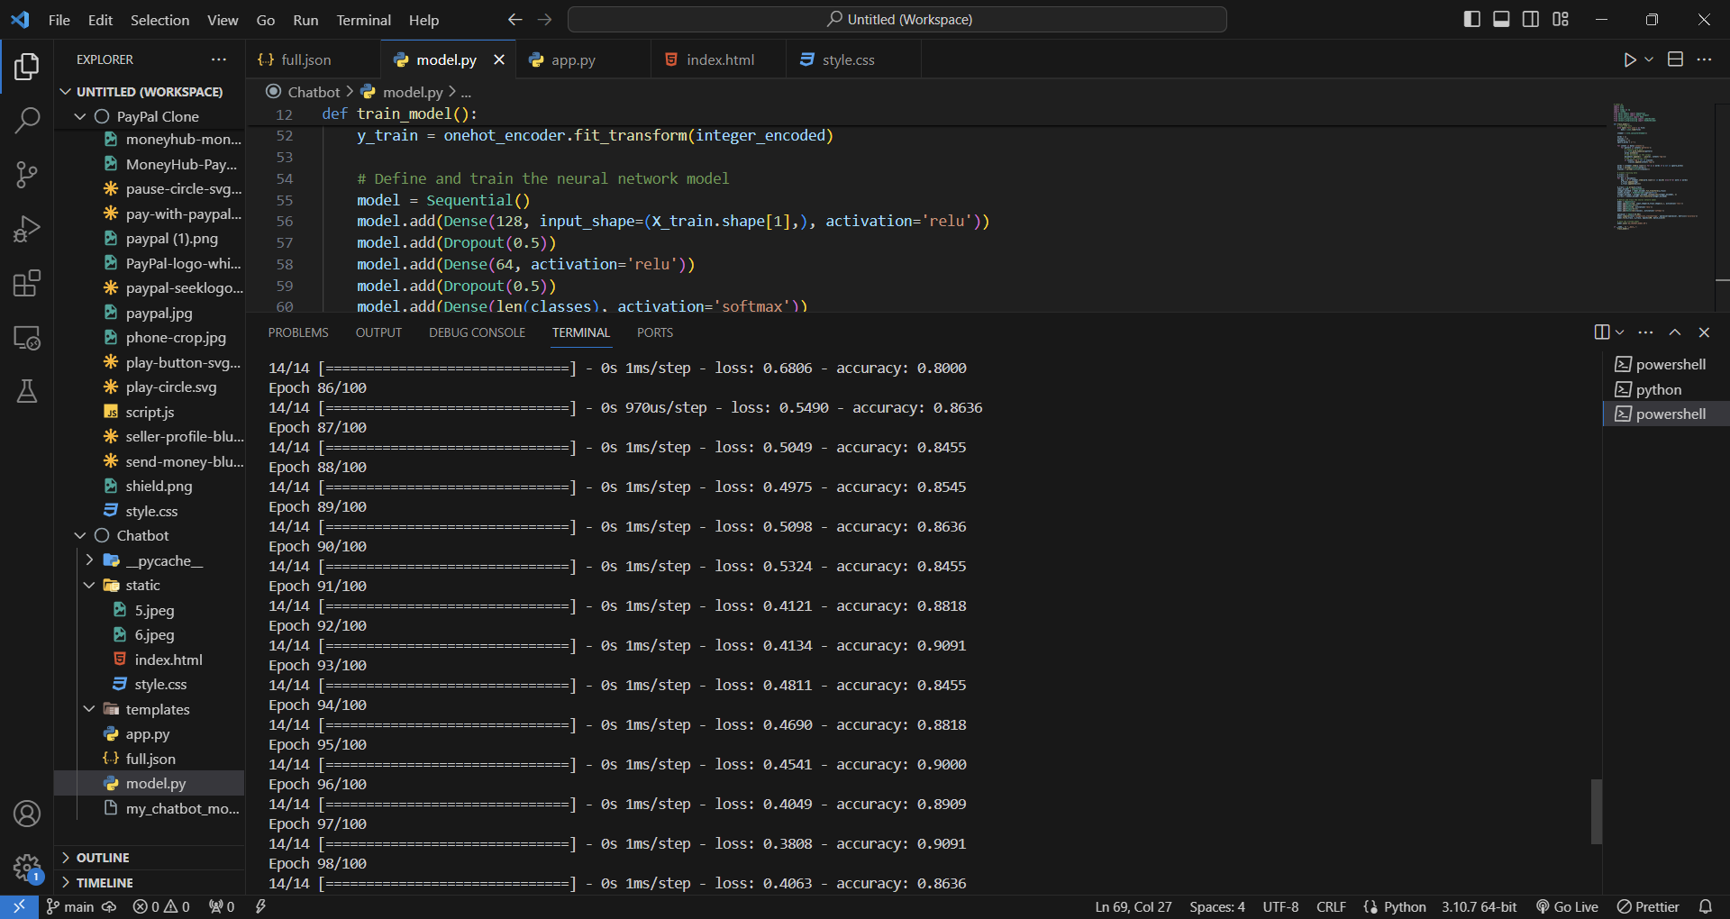
Model Training :

Slide 12
2)INTEGRATING WITH FLASK
Setting Up Shop:
Imagine a shop with tools (libraries) to build a chatbot. We gather Flask (web framework), tools for understanding words (nltk), and tools for working with the brain (Keras) of the chatbot.
We create a workspace (app) and a helper (stemmer) to shrink words to their core (run -> running).
We gather instructions (data) on how people talk to the chatbot from a file.
Understanding You:
We take your question and break it down into separate words.
We check if these words are in our list of important words and create a special code (bag of words) to represent your question.
We ask the chatbot's brain what kind of question this is based on the code.

Slide 13
Giving You an Answer:
The brain checks its knowledge (data) and finds the conversation that matches the kind of question you asked.
It picks a random answer from that conversation.
If the answer needs a special code (like a booking ID), it creates one and puts it in the answer.
Chat Interface:
You see a web page where you can type your questions.
When you hit submit, it sends your question to the shop.

Slide 14
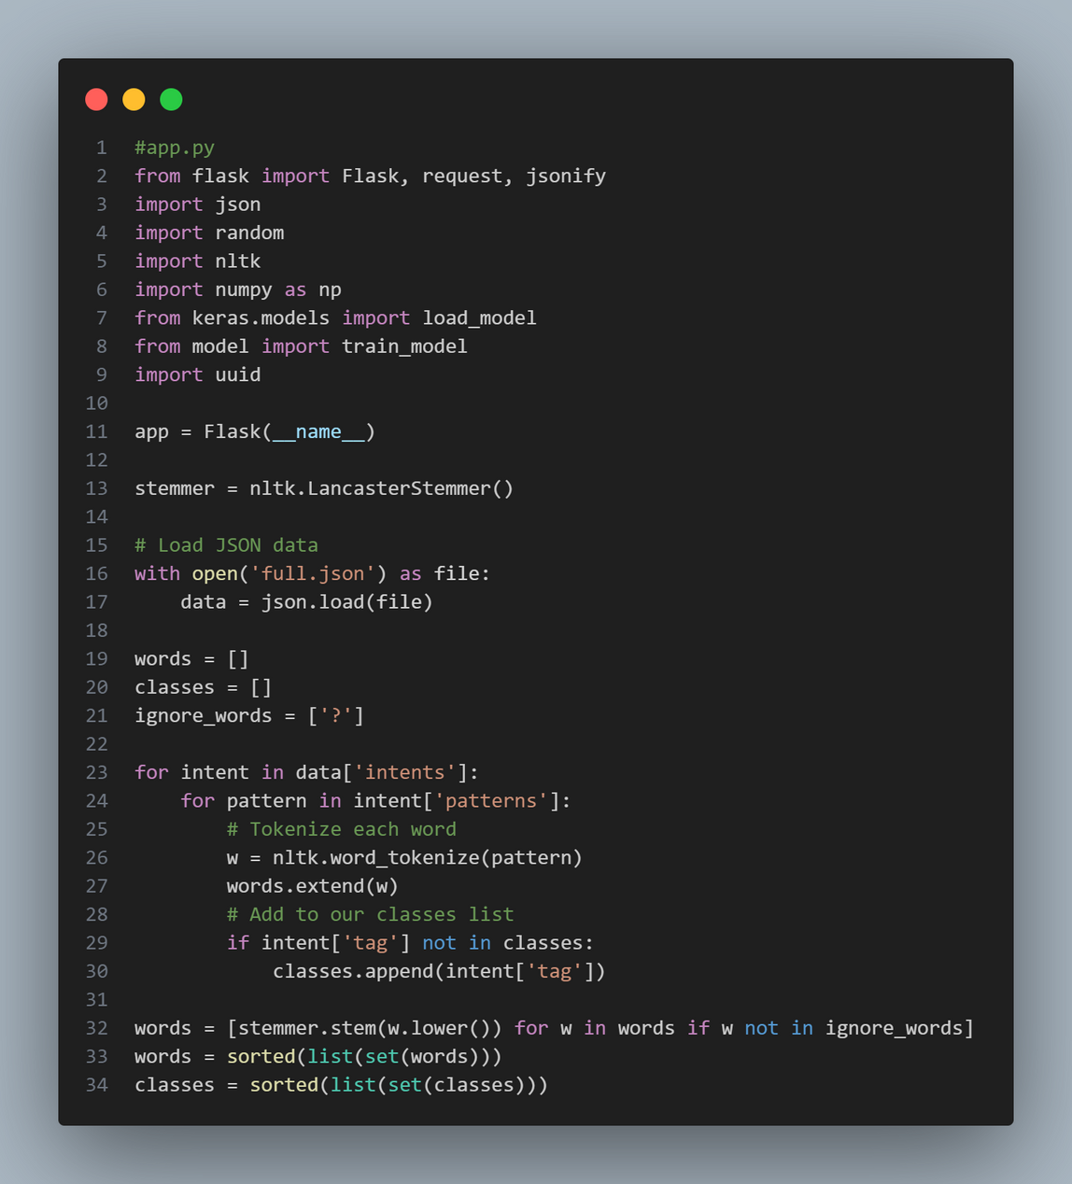

Slide 15
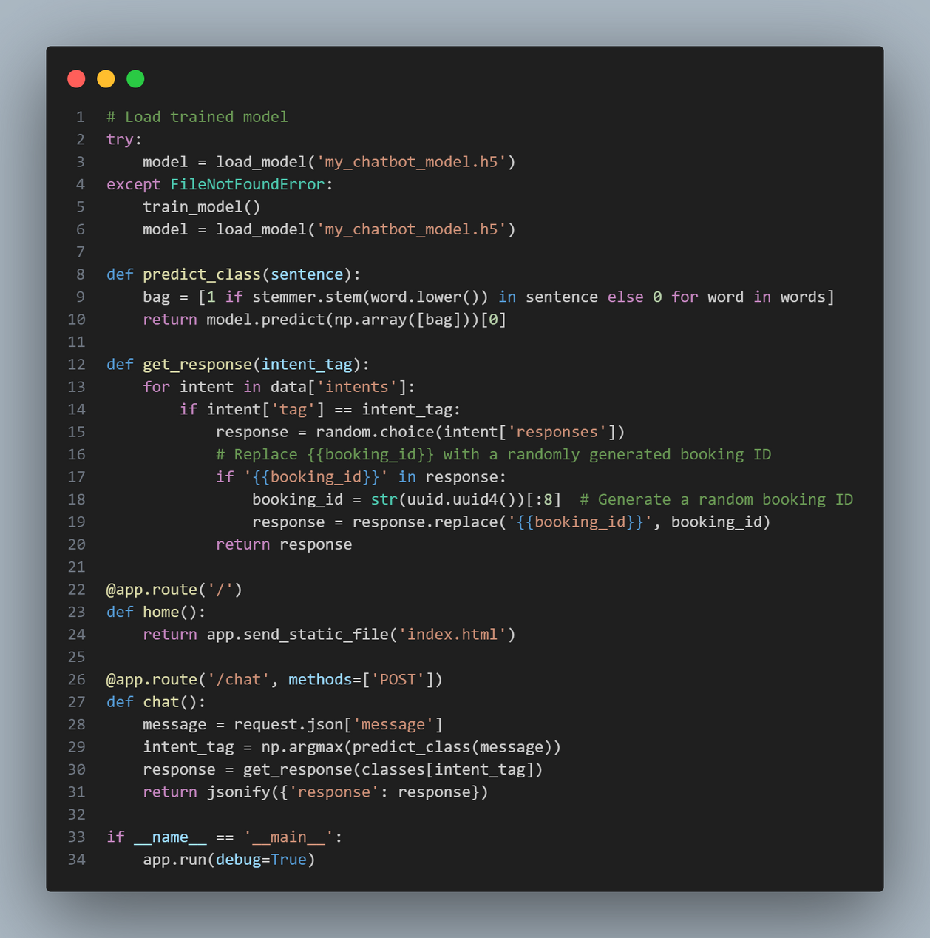

Slide 16
3)USER INTERFACE
For User Interface I used both HTML and CSS to design a visually appealing interface.
I used Background Image, Logo for the Restaurant, Website logo etc.
In this interface I added scrolling functionality to the chat box menu.

Slide 17
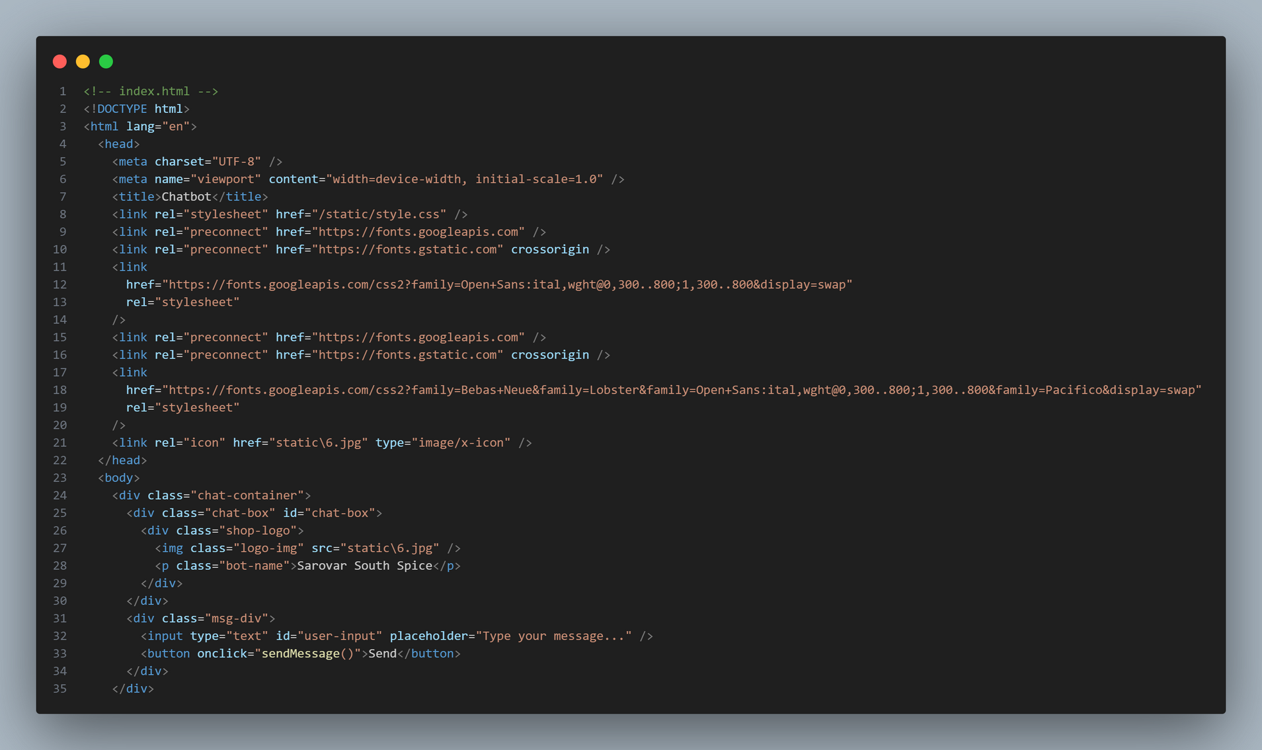

Slide 18
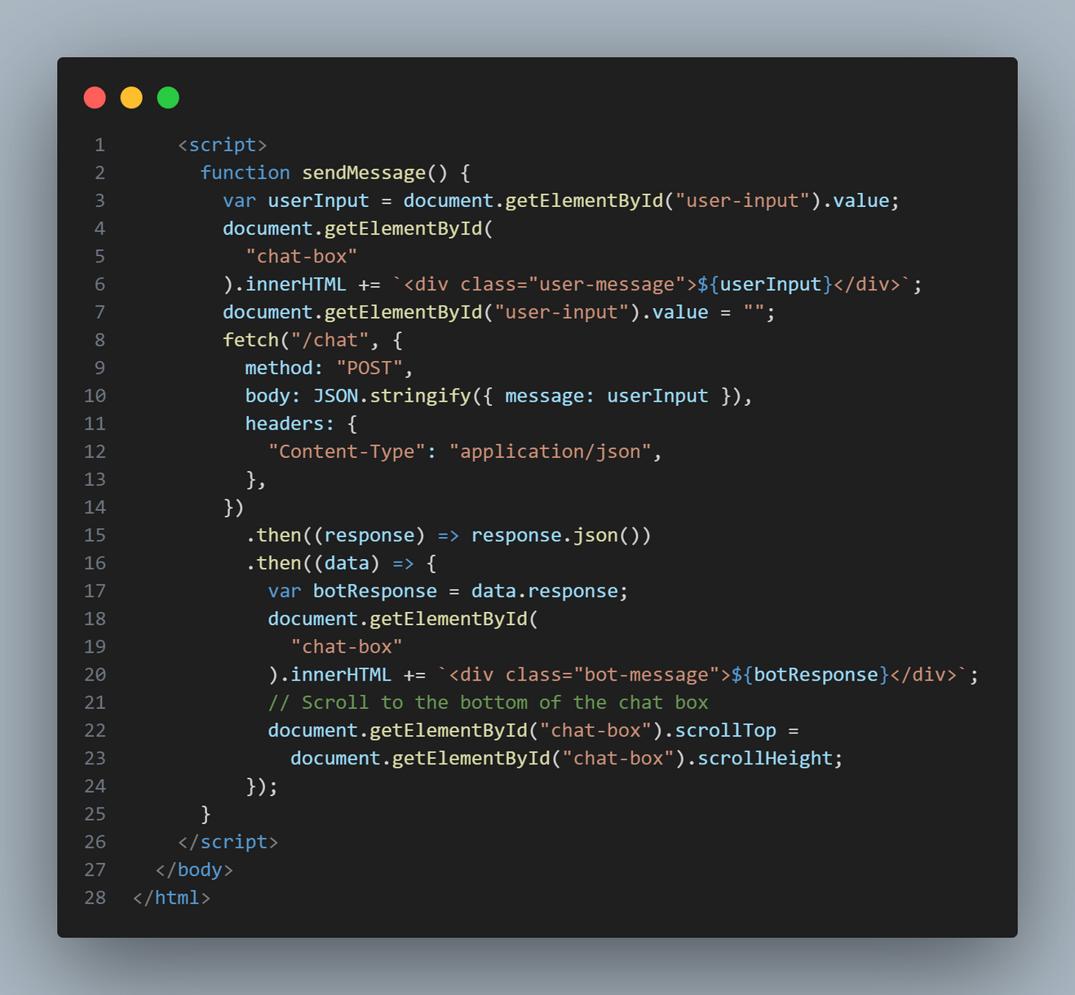

Slide 19
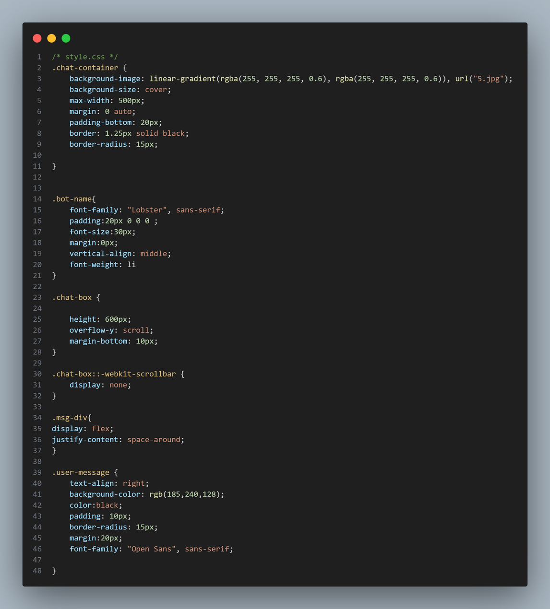
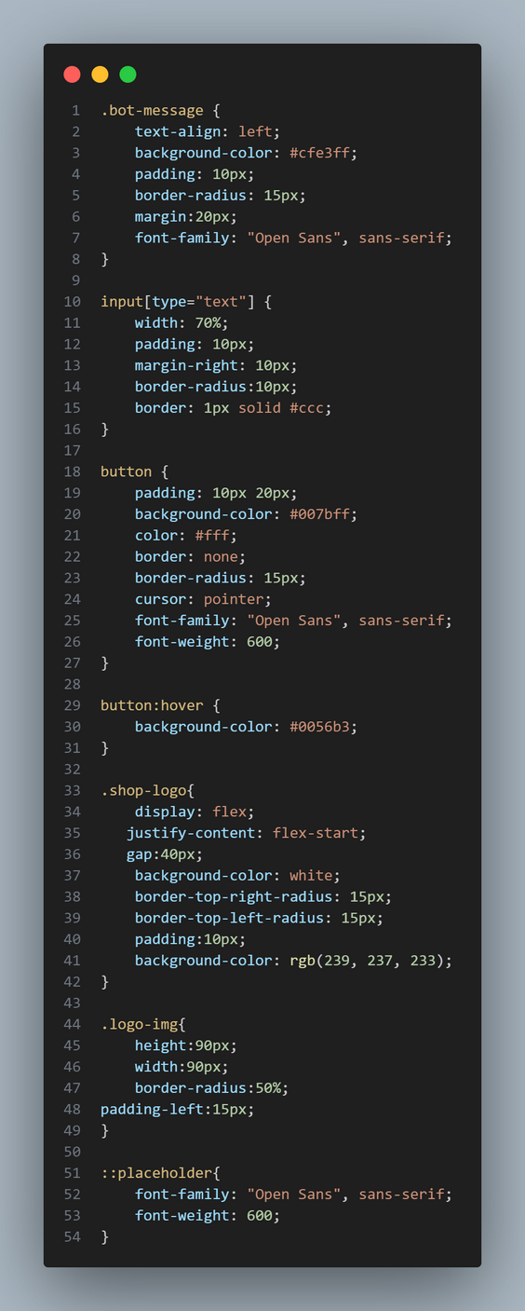

Slide 20

THE WOW IN OUR SOLUTION
Visually appealing user interface
Responsive interaction
Accuracy rate achieved
Simple to understand
Simple to use

Slide 21
MODELLING
Training:
We show the recognizer many conversations, like how we show pictures to a child.
•-Each conversation has a label, like "greeting" or "question about weather".
The recognizer learns to recognize patterns in the words to guess the label for new conversations.
Using the Recognizer:
When you ask a question, the recognizer analyzes the words.
Based on what it learned, it guesses the type of question (greeting, weather, etc.).
The chatbot then uses that guess to find the best answer.

Slide 22
RESULTS
I tested the chatbot with many prompts and the replies from the chatbot are amazing perfect
It can book a table in your name by regenerating Booking ID.

Slide 23
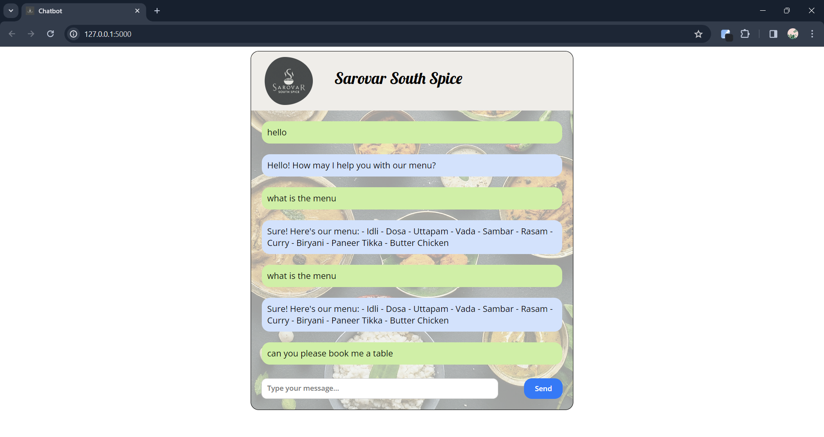

Slide 24
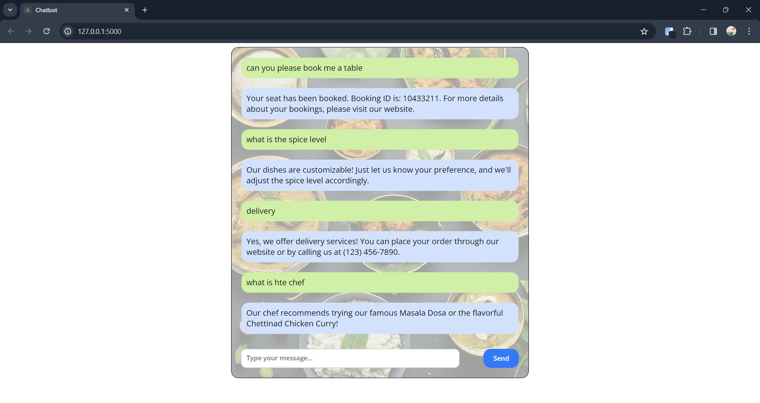

Slide 25
Thank you…

